Slide 1
ReactNative for ios
Krati Jain
06.08.2016

Slide 2



Slide 3
What
React Native is a JavaScript framework for writing real, natively rendering mobile applications for iOS and Android. It’s based on React, Facebook’s JavaScript library for building user interfaces, but instead of targeting the browser, it targets mobile platforms.React Native applications are written using a mixture of JavaScript and XML-esque markup, known as JSX. Then, under the hood, the React Native “bridge” invokes the native rendering APIs in Objective-C (for iOS) or Java (for Android). Thus, your application will render using real mobile UI components, not webviews, and will look and feel like any other mobile application.

Slide 4
Why
Existing methods of writing mobile applications using combinations of JavaScript, HTML, and CSS typically render using webviews.They do not usually have access to the host platform’s set of native UI elements & have Performance bottlenecks.
1.React Native actually translates your markup to real, native UI elements, leveraging existing means of rendering views on whatever platform you are working with.
2.React works separately from the main UI thread, so your application can maintain high performance without sacrificing capability. The update cycle in React Native re-renders the views when state or property changes.

Slide 5
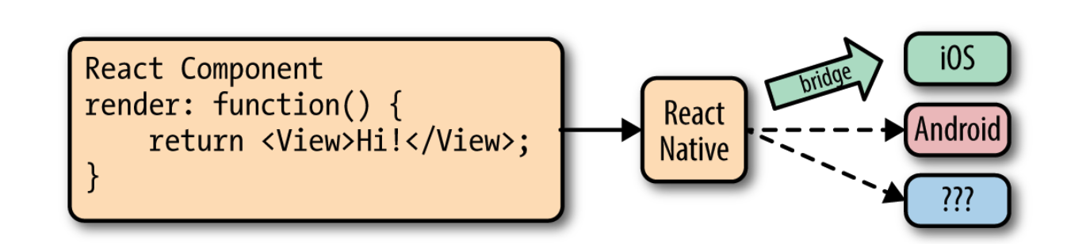
How
In React Native, just as in React, we write our views using JSX, combining markup and the JavaScrip tthat controls it into a single file.
React Native bridge will not expose all host platform functionality. If you find yourself in need of an unsupported feature, you have the option of adding it to React Native yourself.

Slide 6
Behind the Scenes
The shadow queue: where the layout happens
The main thread: where UIKit does its thing
The JavaScript thread: where your JS code is actually running
Plus every native module has its own GCD Queue unless it specifies otherwise

Slide 7
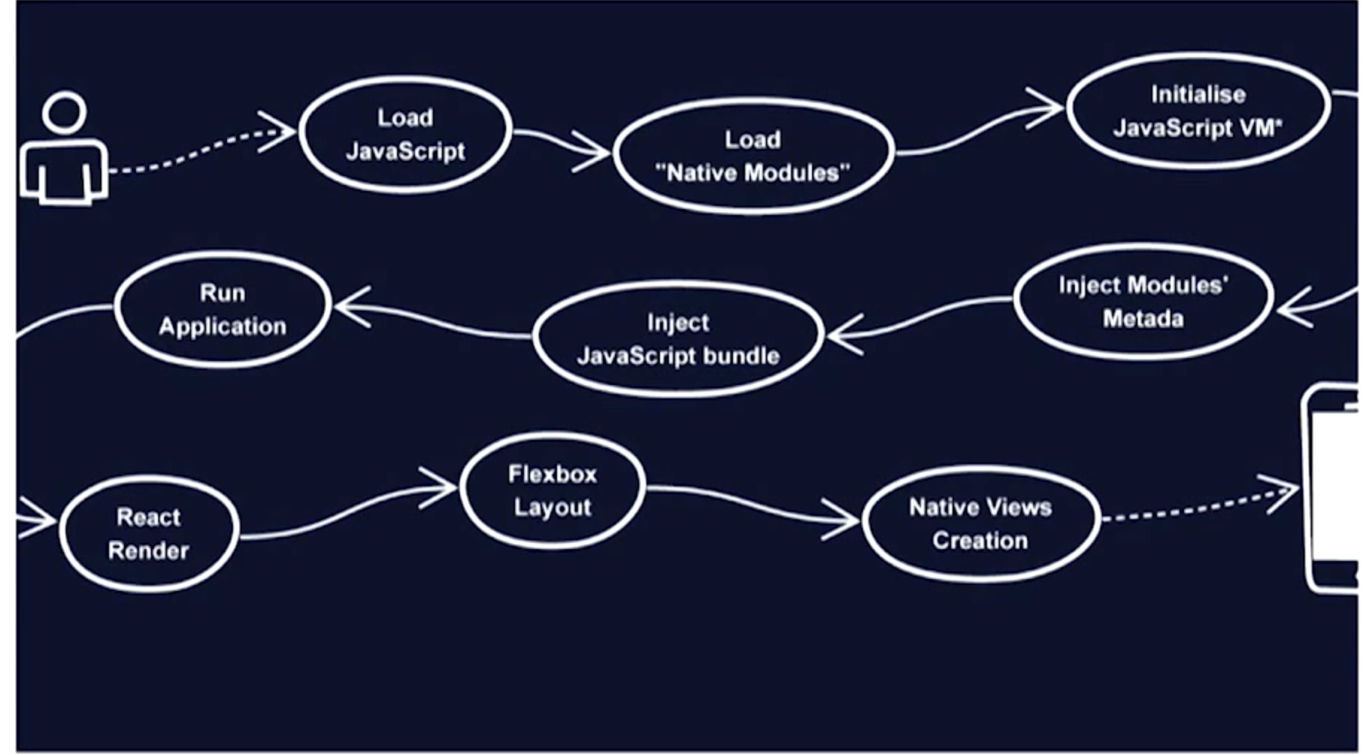

Slide 8
Good,Bad & Ugly
Pros
Because React Native is “just” JSX, you can hit Command+R to refresh your application.
Reduces release cycles
Besides shared knowledge, much of your code can be shared, too.
Any developer who knows how to write React code can now target the Web, iOS, and Android, all with the same skillset
Cons
React Native introduces another layer to your project, it can also make debugging hairier,
the project is still relatively young
Performance issues
Slow navigator transitions
ListView initial rendering is too slow

Slide 9
Hands On

Slide 10
Installation
1.Install homebrew:
ruby -e "$(curl -fsSL https://raw.githubusercontent.com/Homebrew/install/master/install)"
2.Install nvm:
curl -o- https://raw.githubusercontent.com/creationix/nvm/v0.31.0/install.sh | bash
3.Open -bash_profile by entering the following commands:
touch ~/.bash_profile; open ~/.bash_profile
and put the following in it:
export NVM_DIR="$HOME/.nvm"
[ -s "$NVM_DIR/nvm.sh" ] && . "$NVM_DIR/nvm.sh" # This loads nvm
4.Install latest version of Node.js
nvm install node && nvm alias default node
5.Install Watchman
brew install watchman
6.Install flow
brew install flow

Slide 11
First Project
npm install -g react-native-cli
react-native init AwesomeProject
Now open index.ios.js and edit it to reflect changes in your app on Command+R.
Alternatively, you can add ReactNative to your existing project using cocoa pods:
# React native
pod 'React', :git => "git@github.com:facebook/react-native", :tag => 'v0.24.0', :subspecs => [
'Core',
'RCTImage',
'RCTNetwork',
'RCTText',
'RCTWebSocket'
# Add any other subspecs you want to use in your project
]

Slide 12
References
Official RN Site
Getting Started
RN Bridge
Performance
Unit Testing for RN
Crash Reporting
Learning React Native

Slide 13
Thank You!
@kratijain

